Slide 1
Data-Science Getting Started

Slide 2

Introduction Matthias Groh @ SE GP G QPI QM P
Department “Improvement Projects” of SE Generation Quality
Data Science consultant
Six Sigma Master Black Belt
Previous engagements:
Senior Lean Expert focusing on administration processes @ Siemens Energy Fossil Products, Berlin, Germany
Director Six Sigma @ IIL, New York, NY, USA
Six Sigma Black Belt @ Deutsche Bahn, Frankfurt, Germany
Professional degrees in:
Precision Mechanics
Mathematics
Psychology
If you need help, please contact our support mail box: dataScienceSupport.energy@siemens.com
To contact me personally, email me at groh.matthias@siemens-energy.com
Additional qualifications:
Certified Group Facilitator and Trainer (ABF)
Certified Six Sigma Master Black Belt (IIL)
Certified Project Management Professional (PMI)
Certified Senior Lean Expert (LMI)

Slide 3
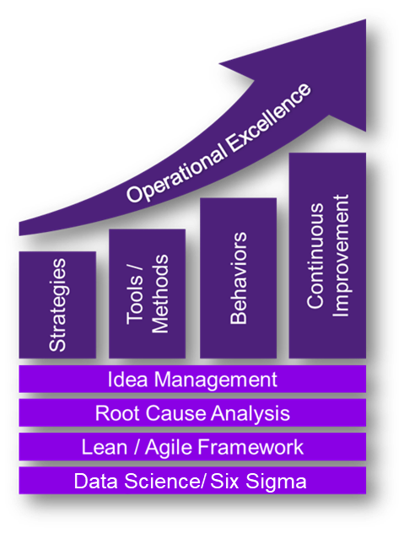


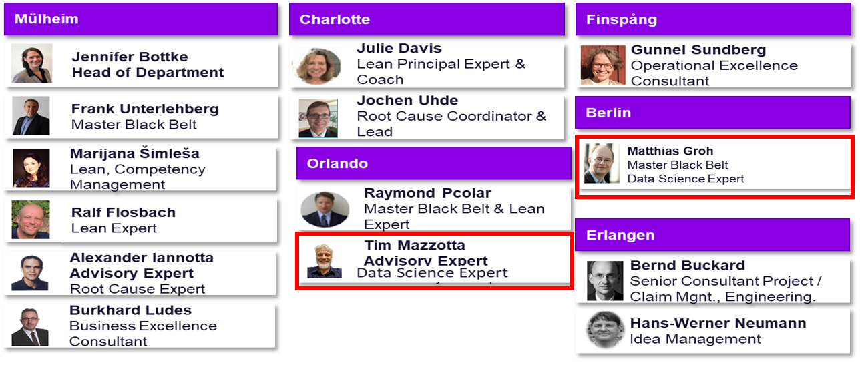
Introduction: Data Science @ SE GP G QPI QM P Improvement Projects
We help your employees getting the skills for the digital future:
Global Data Science Skill Network (with Matt Bryan, LGT R&D)
Data Science and Machine Learning trainings (with several partners):
Currently 11 trainings developed and executed
Attended by >500 participants mostly from R&D
Analytic services in specific improvement projects
EAI CodeShare (with Thomas Buller, LGN R&D)
Data Science @ QPI QM P:
Matthias Groh Master Black Belt
Data Science Expert
Tim Mazzotta Advisory Expert Data Science Expert
Nicolas Schneider
Coop Master Student
Kay Toepfer
Master Student
We help building the bridge between Data Science and daily engineering business.

Slide 4
Presenters & Content Authors
SE G QPI QM P
Tim Mazzotta
Matthias Groh
Kay Töpfer
SE G LRE LGN R&D GNM ELI AM
Christopher Allen
SE G LRE LGT R&D MOD CWE CGER DFM/ AN
Lukas Obermeier
Michael Zaky
Philipp Trinh
Jan Sowa
SE GP G SV TI EN RW TI
Melvin Wandrey
SE GP G SV TI EN RW CRC AC
Nils Singhof
SE G QPI PI TIM FA
Ray Witkins
SE G LRE LGN R&D GNS SUP
Thomas Buller
GP PGO PR R&D SU CSM RTO 1:
Peter Dumstorff

Slide 5
Goal Data Science Workshops: Basic understanding how to use Python and EnergyAI to access power plant data
Workshop Module | Agenda | Goals | Our approach to teaching:
DS 1 Python Basics | Jupyter Notebook Intro Lists, Object Localization Loops, Dictionaries, If Definitions Classes/ Objects/ Methods Intro to Numpy/ ND-Arrays | Target audience (all modules): Any engineer who needs to analyze big data In particular engineers verifying assumptions with power plant data Prerequisites: Basic programming knowledge or DS0 DS1 for DS2, DS2 for DS3 or reading through the scripts New For DS2: "Transforming Data“ = free chapter 1 of "Data Manipulation with Pandas" https://learn.datacamp.com/courses/data-manipulation-with-pandas Teaching goals (all modules): First steps to learn the topic is taken. Basic concepts are understood ->just enough to keep learning from online sources. Everybody learns in the workshop, also trainers. This is a teaching “Minimal Viable Product” | Handling of questions: For understanding questions ask right away For major problems go to separate helpline Teams meeting: one of the teachers will join you as a coach Expert discussions moved to break or afterwards With a wide range of participant’s knowledge: Target speed is for 20% too fast / for 50% too slow We will record the session (please remind us). Please give us feedback afterwards – we will improve.
DS2 Python: Pandas and Seaborn | Prerequisite OnlineTraining “Transforming Data”: Intro data frames + basic editing Overview methods for data frames https://learn.datacamp.com/courses/data-manipulation-with-pandas Recap Handling Nans Resample and Fill Calculation with dataframes PickleFormat Connecting dataframes Intro Visualization with Seaborn
DS 3 Data Pulling in Energy AI | Intro Data Pulling Time Interval Plants, Units and Signals Period, Aggregation Fill, Thresholds, Poststresholds Plotting with Seaborn (cont.) Examples

Slide 6

How This Training Works
Experiment, we are all learning
DS0-> DS1->DS2->DS3 are prerequisits (enough to read through scripts)
New For DS2: "Transforming Data“ = free chapter 1 of "Data Manipulation with Pandas“ https://learn.datacamp.com/courses/data-manipulation-with-pandas
1x10 Min Break in each 2h block
Recording: high demand, few training seats
Based on interaction
Discussions, Exercises + Debriefs
Harder in Teams
If I should not call on you, please tell us now

Slide 7
Links
Our training yammer page:
https://web.yammer.com/main/groups/eyJfdHlwZSI6Ikdyb3VwIiwiaWQiOiIxMzAyMjM3MTg0MSJ9/all
Evaluation:
https://forms.office.com/Pages/ResponsePage.aspx?id=PqlLJW8f80iQ5uJ2ZmS0d-5LdjYRShZEhN3YmsD7St9UREFCNlJTVlRaMVVLNkVOVTNaN09IMTA3MC4u

Slide 8
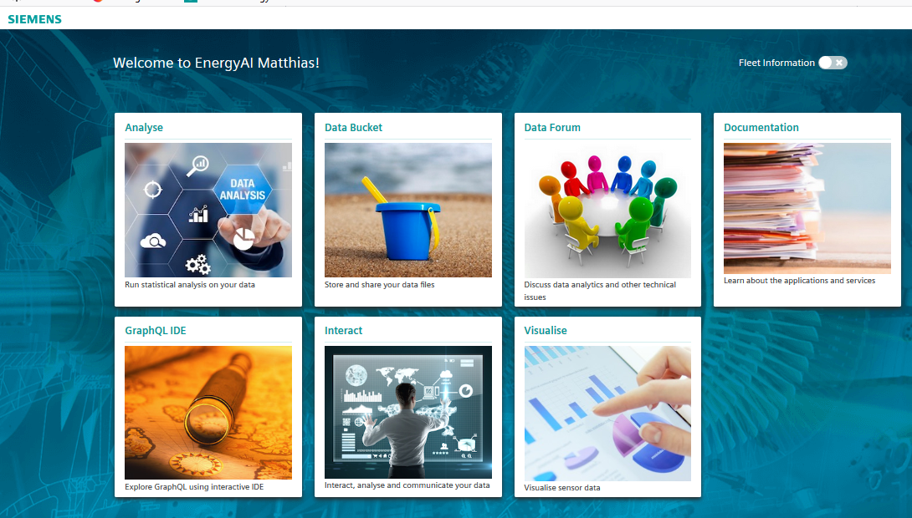
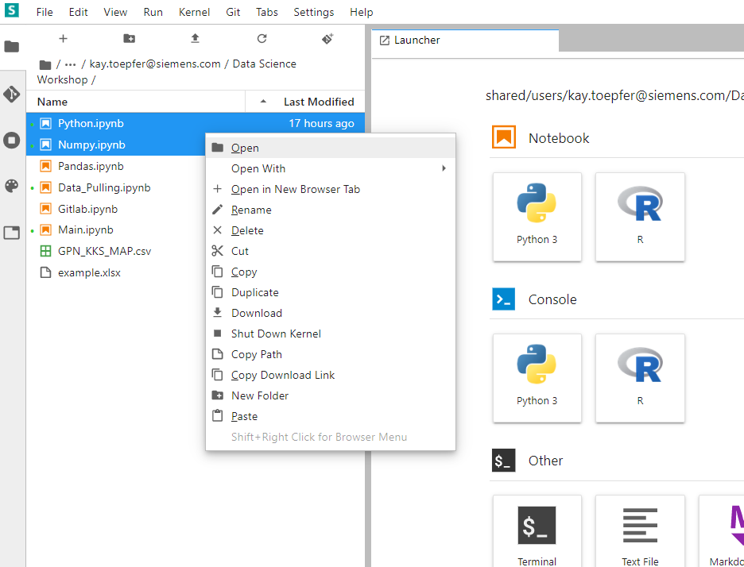
Introduction
Name, Department
All prerequisites fulfilled? EnergyAI, knowledge of previous trainings (DS0->DS1->DS2->DS3)
Preexisting knowledge program, data science, statistics, Python, R, …
Expectations
Side Task:
Go to Energy AI https://energyai.siemens.cloud/home and clicked on Analyze.
Please use Edge, Firefox or Chrome, not MS Explorer
Copy all Files from shared->User->Kay.Toepfer…->DataScienceWorkshop
Follow detailed instructions starting on slide 25, if this does not work go to the helpline
Click!

Slide 9
First Steps – My first Analysis
Main.ipynb
The notebook Main.ipynb contains a basic example on how to pull and analyze data via EnergyAI.
On Data Hub and its functions
On Python and its libraries
Data_Pulling.ipynb
Contains more detailed information about pulling data in EnergyAI.
Python.ipynb
Explains basic Python functionalities.
Pandas.ipynb
The statistical and data analysis Python library Pandas.
Numpy.ipynb
The Numeric Python library – for scientific computing in Python.

Slide 10
DRAFT: Data Structures in Python (Grey), Numpy (Green) and Pandas (Orange)
 | Description | Useful for… | Example
Lists | Store collection of heterogeneous items – immutable and mutable objects | Simple listing Special programming techniques (Stacks, Queue, Graphs, Trees) | [item, item, item]
Dictionaries | Collection of key-value pairs Key: immutable objects Value: heterogeneous items – immutable and mutable objects | Creating loops to do the same operation on many dataset | {key1:item1, key2:item2}
Files | Store and retrieve previously stored information |  | .csv, .hdf5, .xlsx
Tuples | Tuples are data structures in which the content can not be changed after creation (no deletion, add or edit) | Prevents data manipulation | (item, item, item)
Sets | Collection of unique objects | Creating lists that only hold unique values Helpful when going through huge dataset | {item, item, item}
Numpy ND-Arrays | Store collection of data of the same type | Dealing with large collection of homogeneous data types: easier to use, faster and uses lesser memory than lists Support vectorized operations Work efficiently with large datasets with lots of empty cells | [[1. 1. 2.] [3. 5. 8.] [5. 3. 2.]]
Dataframes | 2-dimensional labeled data structure Columns don’t have to have the same data type | Data mining / manipulation Labeling Multiindexing | Like this table
Series | One-dimensional labeled array capable of holding any data types | Axis labels | a 1 b 2 c 3
Source: www.datacamp.com, pandas.pydata.org; Also see: https://www.datacamp.com/community/tutorials/data-structures-python

Slide 11
DRAFT: A Selection of Important Libraries in Python
Category | Name | Description | Link
Data Handling Libraries | Numpy | Basic Library for scientific computing in Python (linear algebra, numerical functionalities etc.) | https://numpy.org/
 | Pandas | Package especially built for data analysis | https://pandas.pydata.org/
 | Scipy | Mathematical and engineering functions (e.g. optimization and fits, numerical integration…) | https://www.scipy.org/
Plotting Libraries | Matplotlib | 2D plotting library for basic plotting | https://matplotlib.org/
 | Seaborn | Is built on top of matplotlib, thus offers more functionalities | https://seaborn.pydata.org/
 | Plotly | Is built for interactive graphs | https://plot.ly/python/
Machine Learning Libraries | TensorFlow | For machine learning applications (e.g. voice recognition) | https://www.tensorflow.org/
 | SciKit-Learn | For machine learning applications (e.g. regression models, clustering, vector-machines…) | https://scikit-learn.org/stable/
Other Useful Libraries | Time | Provides all time-related functions | https://docs.python.org/3/library/time.html
 | Sys | For interaction with interpreter (advanced) | https://docs.python.org/3/library/sys.html

Slide 12
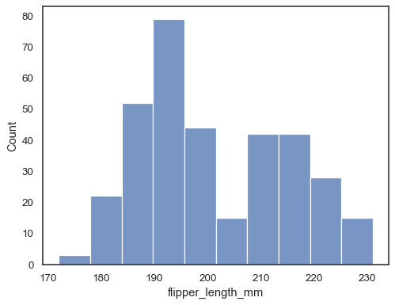
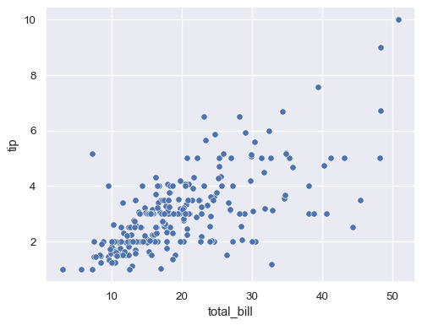
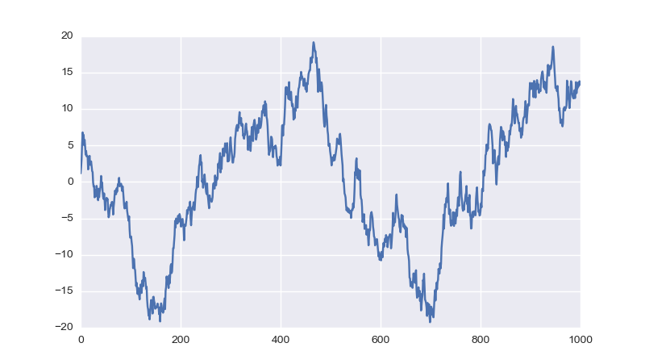
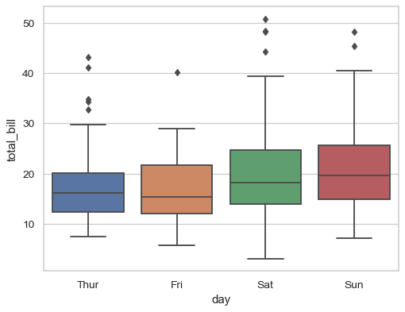
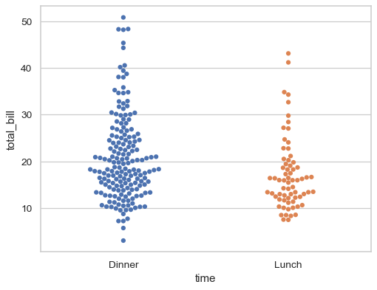
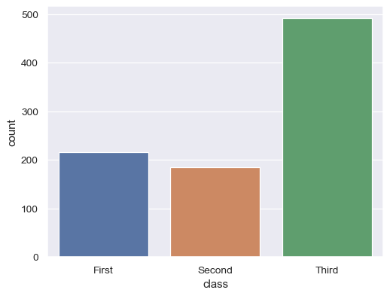
Overview: Essential Graphs of Seaborn
Name | In SNS | Useful for | Plot | Relative to … | Target variable
Histogram | .histplot() | Central tendency Spread Distribution Outliers |  |  | Continuous data
Scatterplot | .relplot() X-Axis is continuous | Correlation Outliers |  | … other continuous data
Lineplot |  | Time effect Spread Outliers |  | … time
Boxplot | .catplot() X-Axis is categorical | Group effects Central tendency Spread Distribution Outliers |  | … categorical data
Swarmplot
Countplot |  | Counts group effects |  | … categorical data | Quantitative data

Slide 13
Definition Data Science
Data science is a multi-disciplinary field that uses scientific methods, processes, algorithms and systems to extract knowledge and insights from structured and unstructured data. ^{[1]}
Technical Domain Knowhow
Data Engineer
Math, Stats, Algorithms
Software Engineering
Data Scientist
Data Analyst
Data Communication
Data science includes “new” (Machine Learning) and “old” (conventional analytics).
[1] en.wikipedia.org/wiki/Data_science

Slide 14
Our focus in the digitalization world is Data Science
Our Focus
Data Science
Business Intelligence
Focus on quantitative data
For Example:
Power plant sensor data
Manufacturing data
Component design analysis data (FE, CFD, CHT, …)
Test rig data
Focus on qualitative data
For Example:
Manufacturing and supply data in SAP
Qualitative fleet data (Fleet Intelligence)
PCM
Of course everybody needs a bit of both data types, but without focusing nobody gets anywhere…

Slide 15
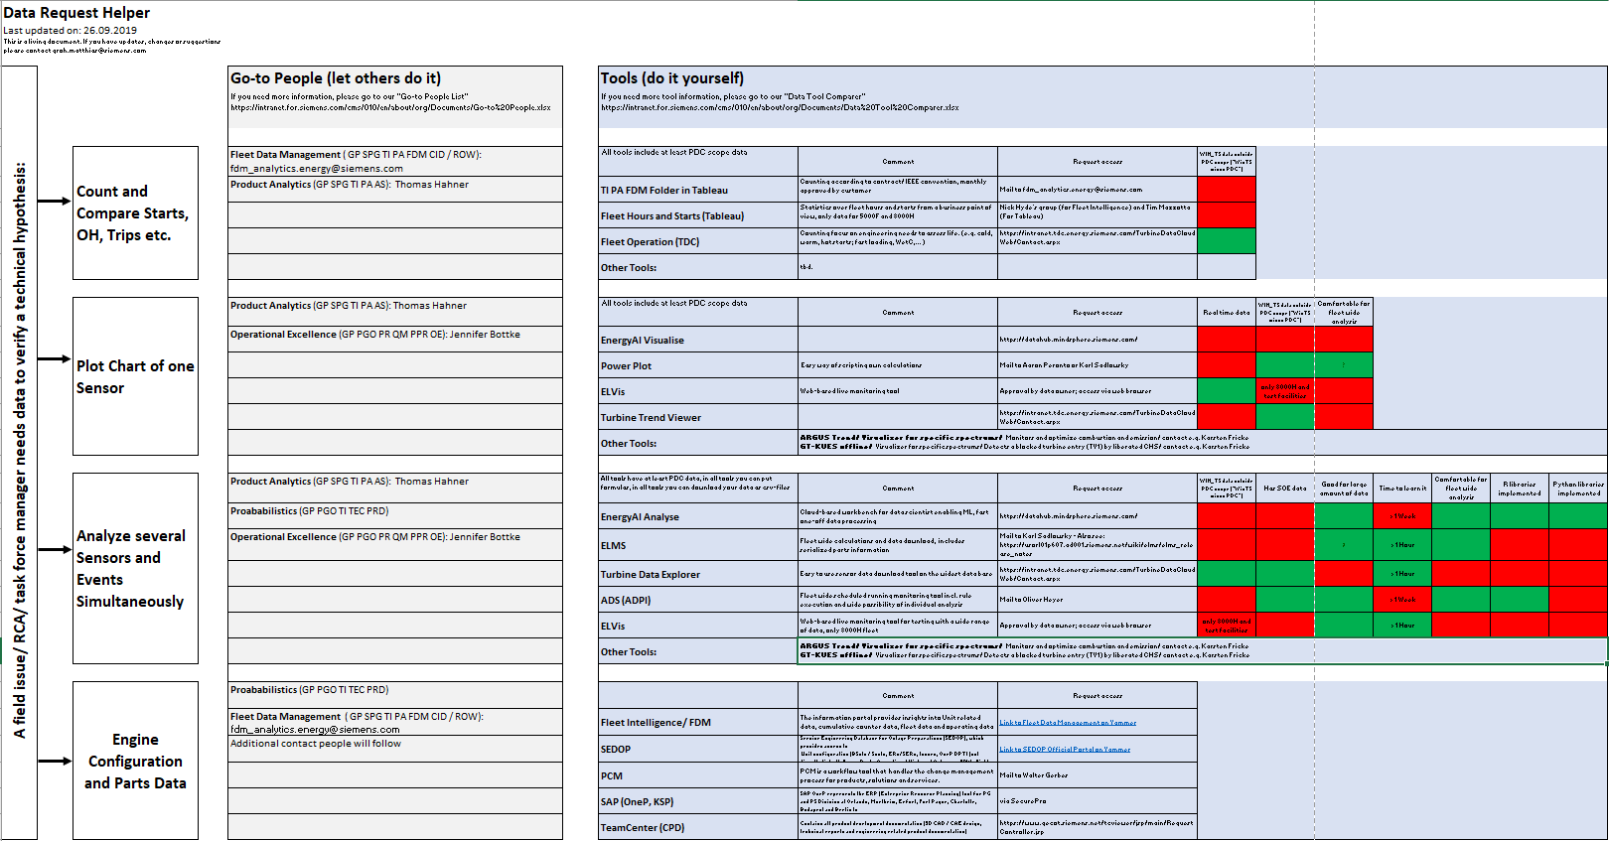
Data Science for Field Issues (1 of 2) The Data Request Helper
https://wse10.siemens-energy.com/content/P0002338/_layouts/15/xlviewer.aspx?id=/content/P0002338/Documents/Data_Request_Helper.xlsx
Our Focus
Our vision: Anybody at GP gets # starts for a given time within 1h, complex sensor data < 2 days.

Slide 16
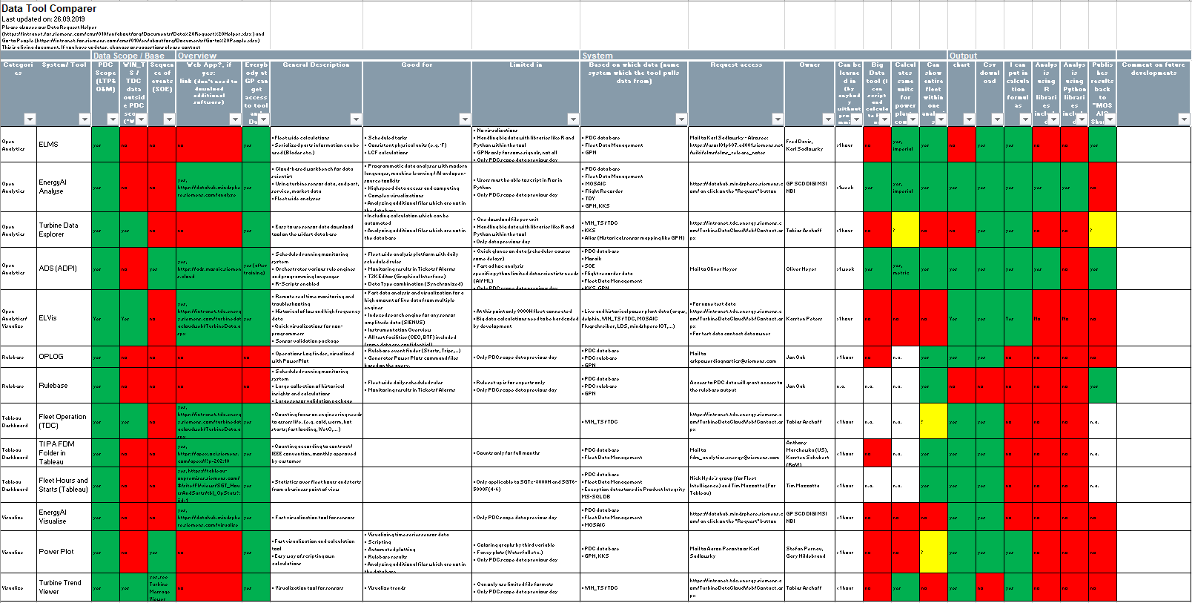
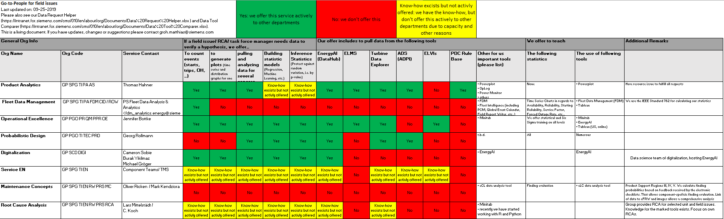
Data Science for Field Issues (2 of 2) Data Tool Comparer and Go-to People
Data Tool Comparer
Detailed view of what features each tool has with
Short description
Good for
Limited in
https://wse10.siemens-energy.com/content/P0002338/_layouts/15/xlviewer.aspx?id=/content/P0002338/Documents/Data_Tool_Comparer.xlsx
Go-to People
Detailed list of contacts, their skills and the tools they use
https://wse10.siemens-energy.com/content/P0002338/_layouts/15/xlviewer.aspx?id=/content/P0002338/Documents/Go-to_People.xlsx
Comparing tools and analytic services helps not only customers, but also providers.

Slide 17
EnergyAI - Getting Started
Power and Gas – Large Gas Turbines, Generators

Slide 18
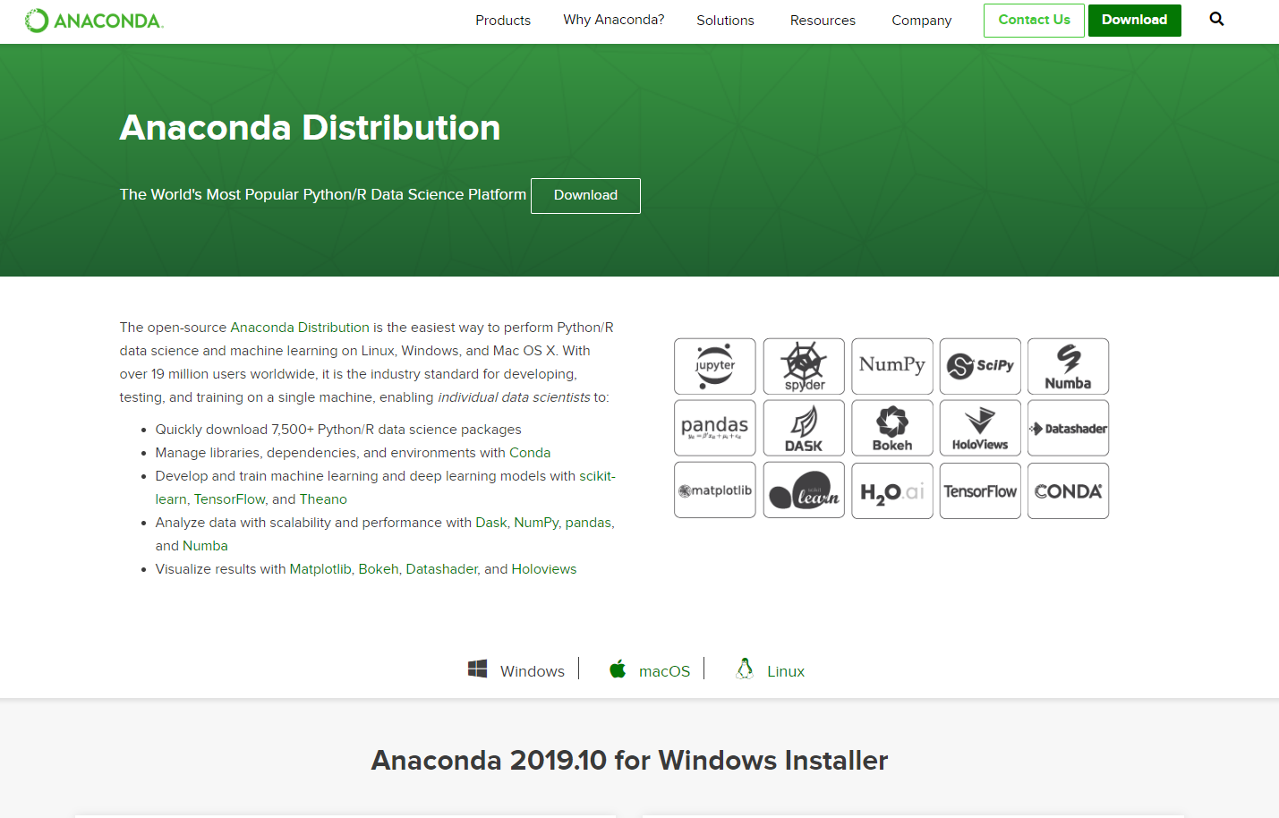
Classical Package for Python: Anaconda
https://www.anaconda.com/distribution/

Slide 19
Why EnergyAI?
The EnergyAI - Analysis platform…
…offers an efficient interface to handle large data requests on multiple plants or units
…enables the user to perform postprocessing on-the-fly, without further data handling steps
…provides a standardized GPN System to address signals across all plants and units
…executes all operations outsourced on a server and makes results available for client

Slide 20
Getting Access to EnergyAI
Setting up an account for EnergyAI (Jupyter Notebook, Python, and R-based access to power plant data):
Go to https://energyai.siemens.cloud/
Click on "Request Access" and fill out the form. Your request will be processed within a few days and further steps will be communicated to you by e-mail
At the same time you get access to the Dataforum (https://forum.energyai.siemens.cloud/categories) where you can create tickets for all problems, which are usually answered within 24 hours
Use Edge, Chrome or Firefox

Slide 21
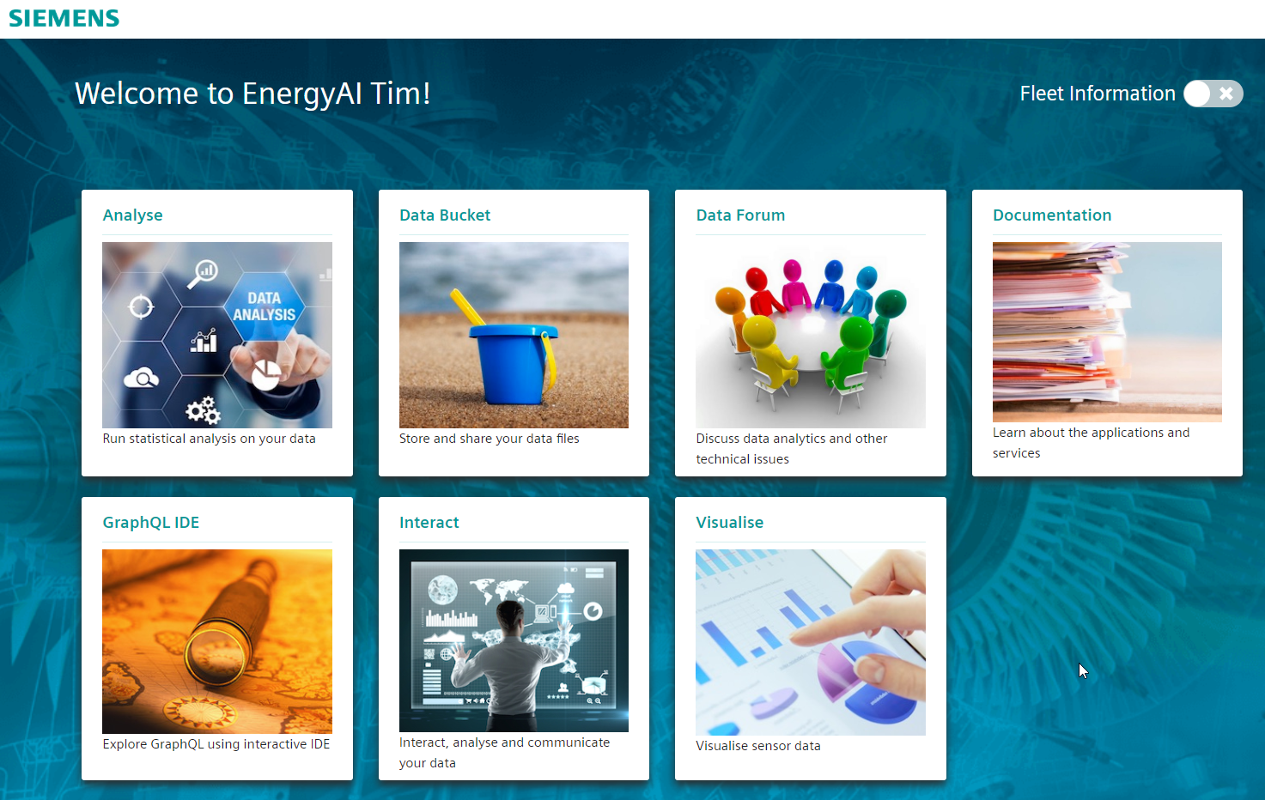
First Steps
go to data forum
perform data analysis

Slide 22
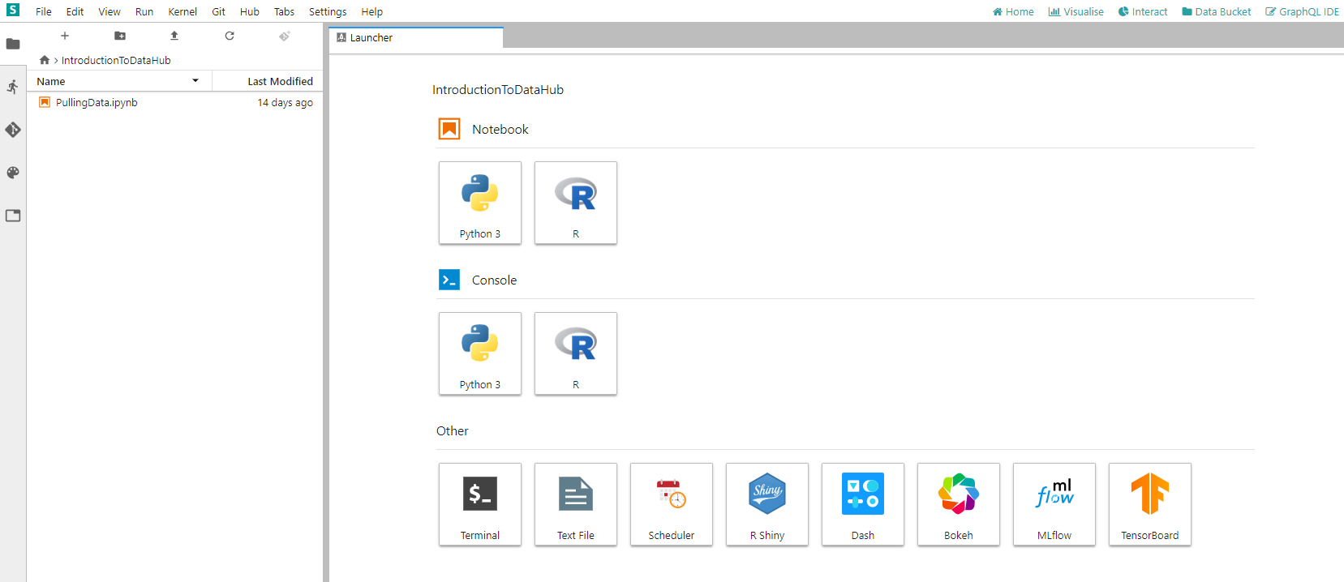
First Steps
Script-based (JupyterLab)
File System
Console-based
more functionalities

Slide 23
First Steps – File System
Hierarchical File System as on Windows
In ‘/shared/groups‘ , it can be worked in groups (group folder has to be requested)
In ‘/shared/users‘ some scripts of other users are visible (copy script in your shared folder to make it visible for others)
Go to: ‘/shared/demos‘ for several demos on the usage of the datahub with R or Python
Repositories from GitHub can be embedded in folders to simultaneously work on scripts (recommended)

Slide 24
First Steps – My first Analysis
go to ‘shared/users/kay.Toepfer@siemens.com/Documentation‘ for an introductory example on how to analyze data via EnergyAI!
Main.ipynb
The notebook Main.ipynb contains a basic example on how to pull and analyze data via EnergyAI.
If you want more information about EnergyAI, data pulling in EnergyAI or Python and its libraries, check out the other provided notebooks. They are referred to in the respective passage in Main.ipynb. Whatsoever, they are not required to understand Main.ipynb. They can be used to gain a deeper insight in the particular topics.

Slide 25
First Steps – My first Analysis
Main.ipynb
The notebook Main.ipynb contains a basic example on how to pull and analyze data via EnergyAI.
On Data Hub and its functions
On Python and its libraries
Data_Pulling.ipynb
Contains more detailed information about pulling data in EnergyAI.
Python.ipynb
Explains basic Python functionalities.
Pandas.ipynb
The statistical and data analysis Python library Pandas.
Numpy.ipynb
The Numeric Python library – for scientific computing in Python.

Slide 26
Go to “Analyse”

Slide 27
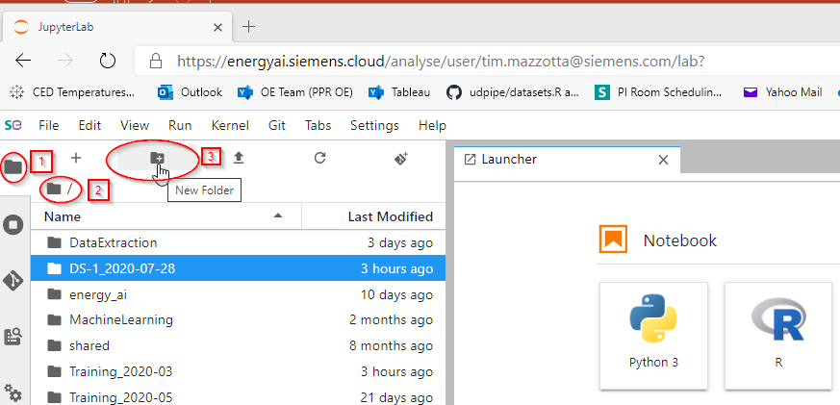
Create a folder for this class
Make sure you have the File Explorer open
Confirm you are at the root level (~/work)
Click the create New Folder button
Recommended name:
DS-1_2020-07-28

Slide 28
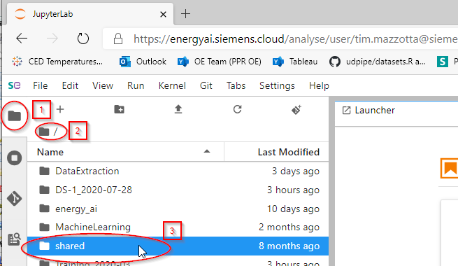
Click on shared
Make sure you have the File Explorer open
Confirm you are at the root level (~/work)
Open the shared folder

Slide 29
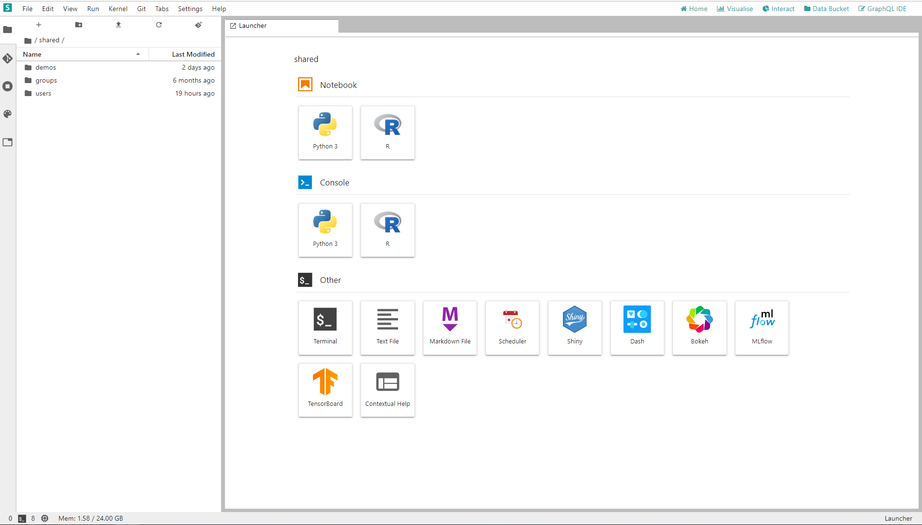
Click on users

Slide 30
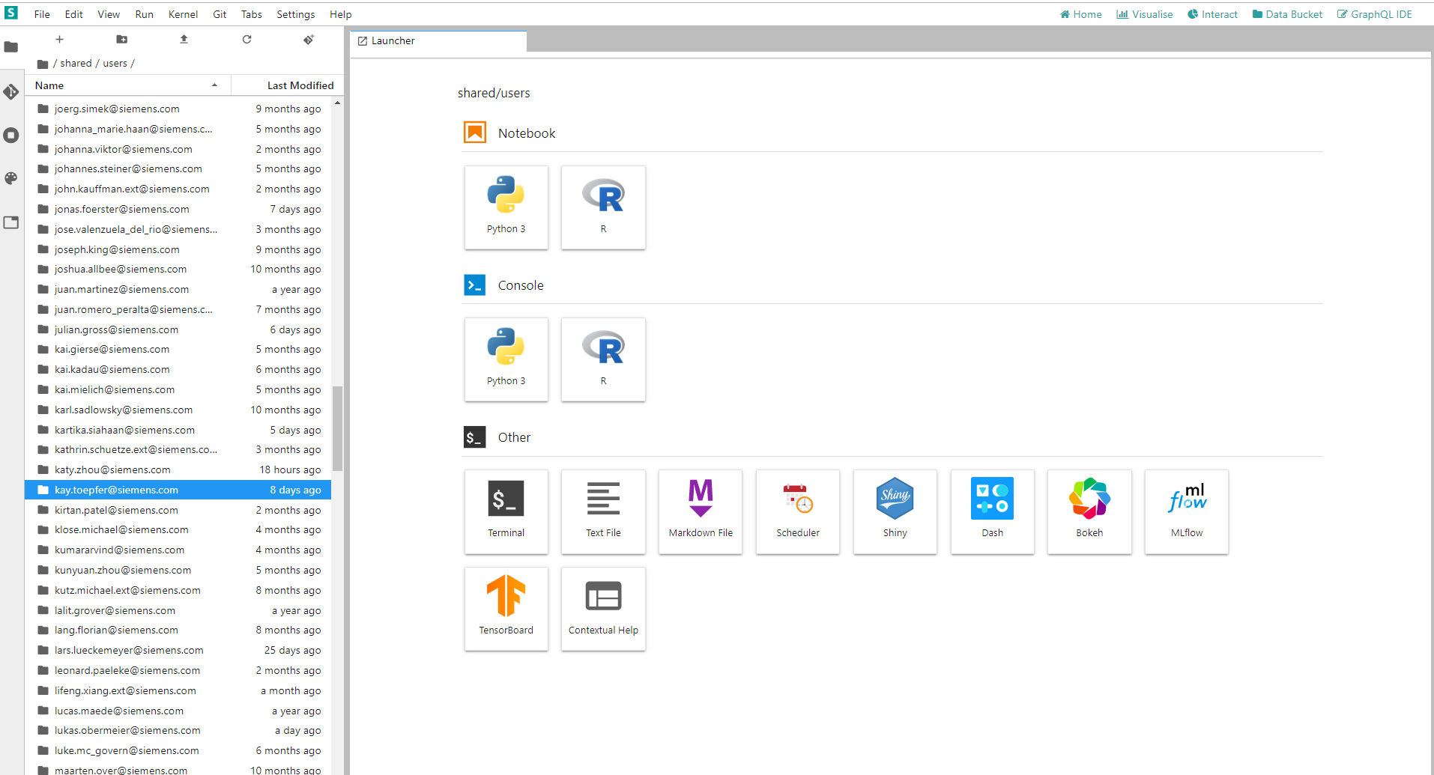
Search for kay.toepfer@siemens.com

Slide 31
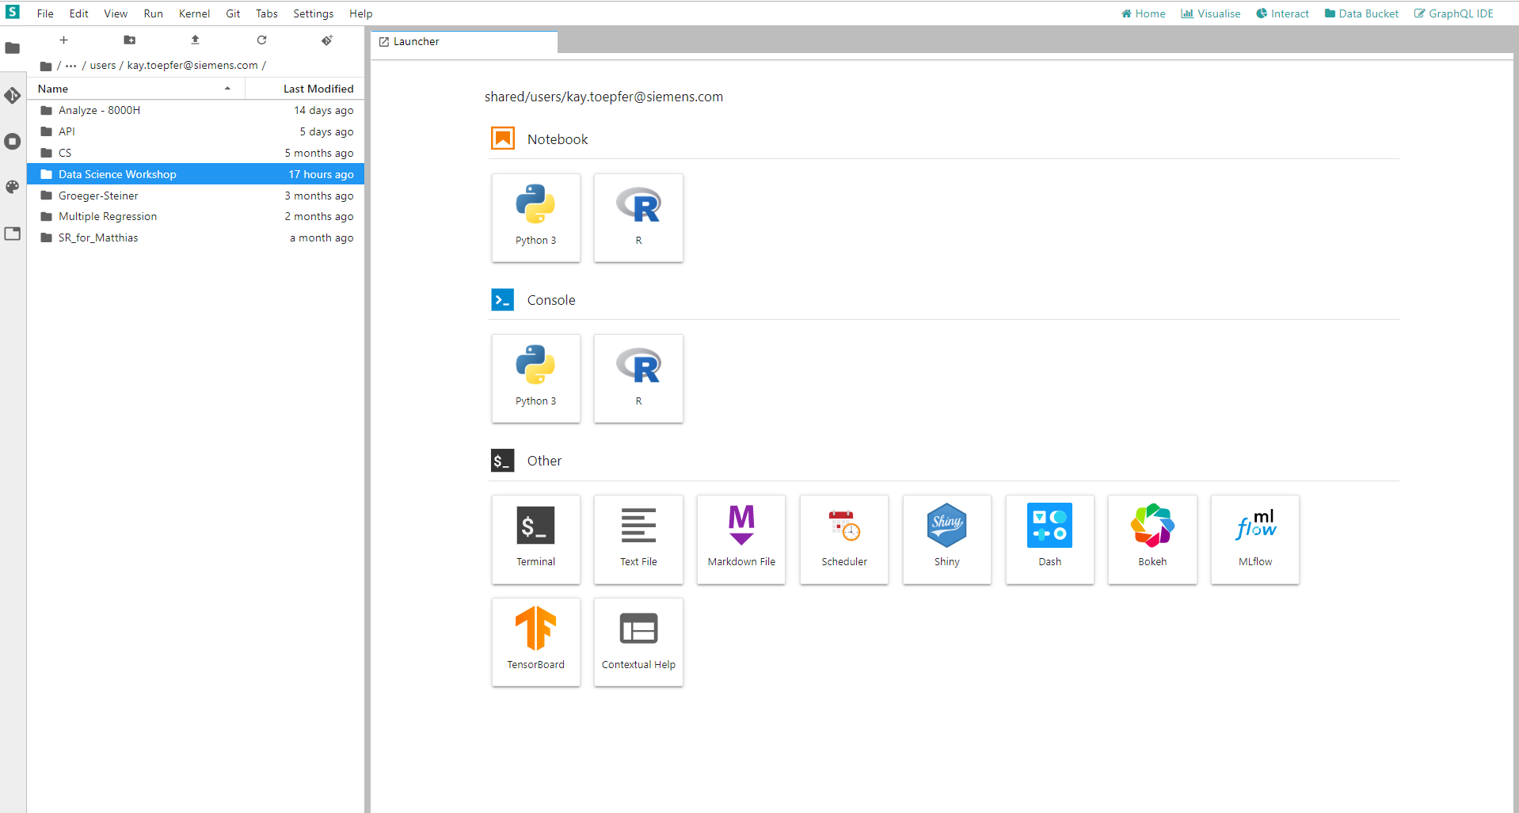
Go to Data Science Workshop

Slide 32
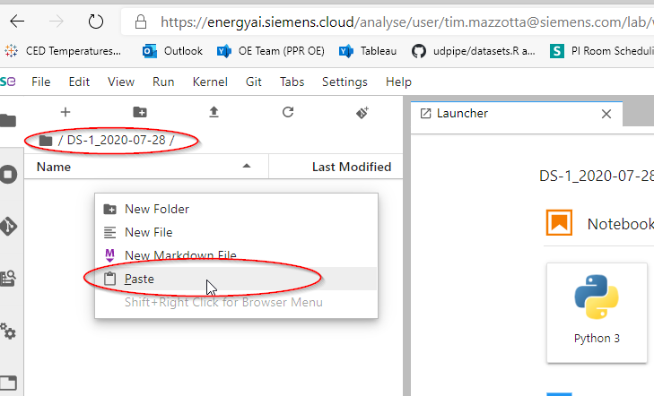
Copy the modules you need in your own folder

Slide 33
Application Example
Power and Gas – Large Gas Turbines, Generators

Slide 34
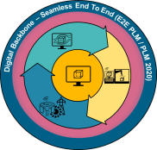

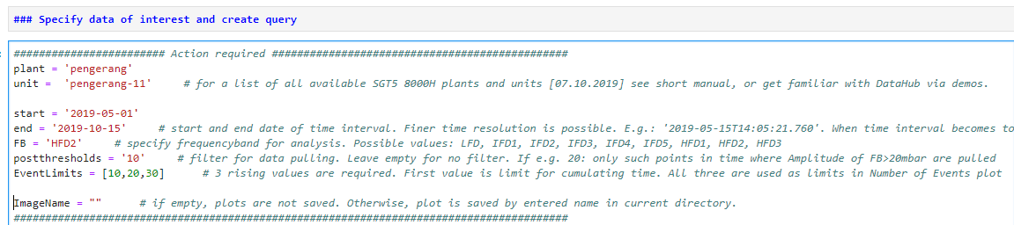

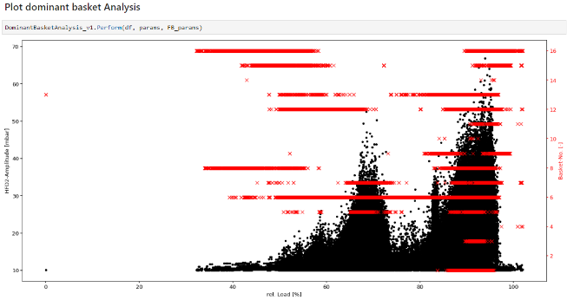
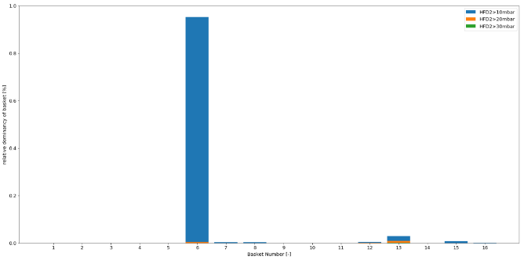
Application Example: Energy AI Efficient Tuning Back Office Support and Engine Validation
Past Situation
Individual approach to engine data analysis w. different tools/mix of tools
Routine tasks require high repetitive manual effort w/o value add
Post processing is done locally & extracted data is rarely shared
Local analysis strongly limited by CPU/RAM/disk space
Improvement
Energy AI (a.k.a. Datahub) allows easy standardization in collaborative & performant environment
Python scripts automate routine post processing tasks ➔ engineer can focus on value add tasks
Fast turnaround times even for large datasets
Example Shown: Python script on Energy AI runs analysis of HFD activity in 8000H in terms of amplitudes and HFD activity per basket;
Script provides analysis for 5 month period in ~60 seconds where doing the same thing for a mere two day period in conventional manner takes several hours

Slide 35
Additional Features in EnergyAI
Power and Gas – Large Gas Turbines, Generators

Slide 36
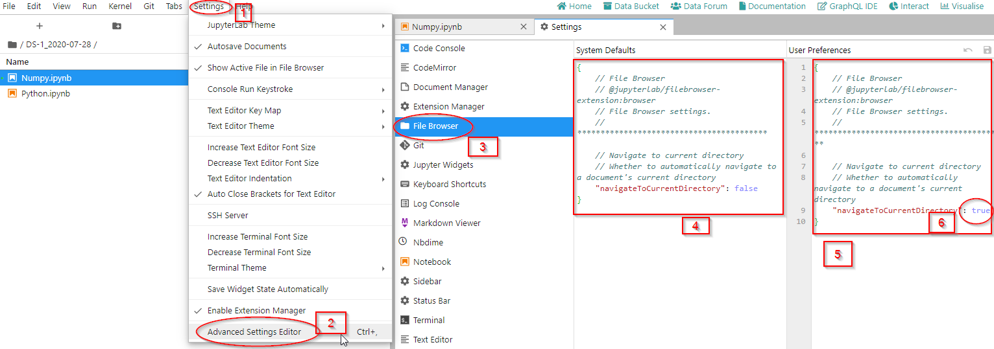
Advanced Settings: (1 of 2) to Easier Move between Folders for Opened Notebooks
Click: Settings
Click: Advanced Settings Editor
Click: File Browser
Copy
Paste
Modify

Slide 37
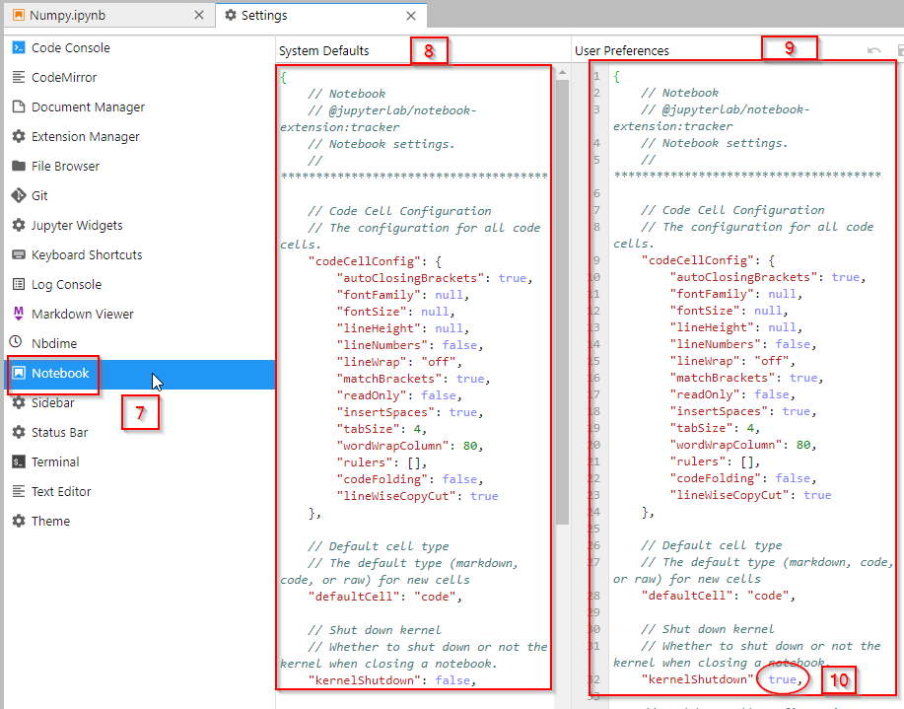
Advanced Settings: (2 of 2) to Shut Down Kernel Automatically when Closing Notebook
7) Click: Notebook
8) Copy
9) Paste
10) Modify

Slide 38
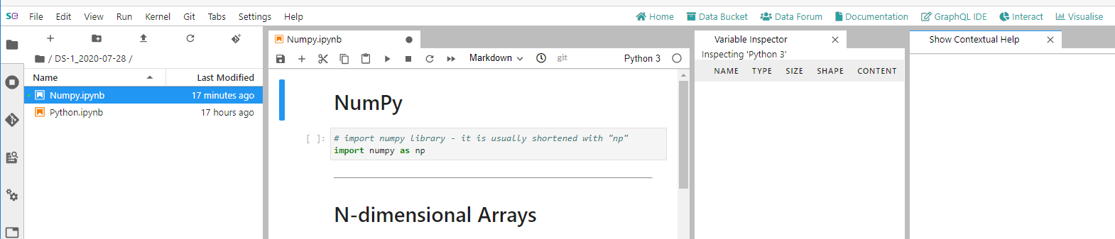
Open up a file and set up view by docking Context Help and Variable Inspector

Slide 39
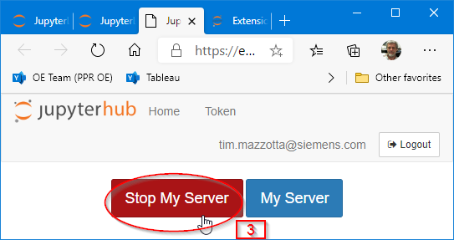
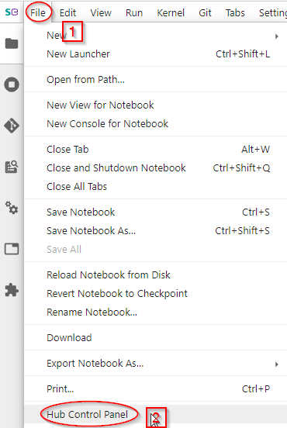
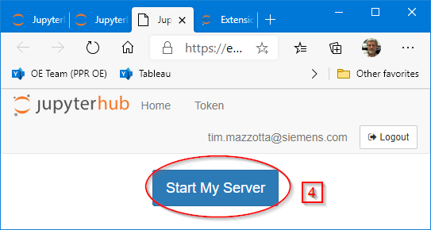
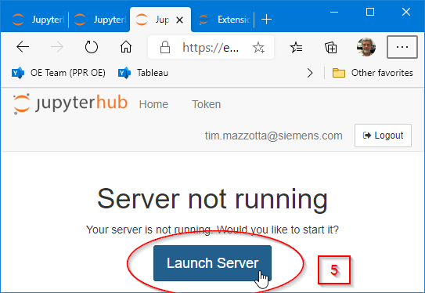
Trouble Shooting !!! ONLY RUN IF PROBLEMS !!!!
info

Slide 40
Additional Slides for Data Science 2 Vectorized Calculations
Power and Gas – Large Gas Turbines, Generators

Slide 41
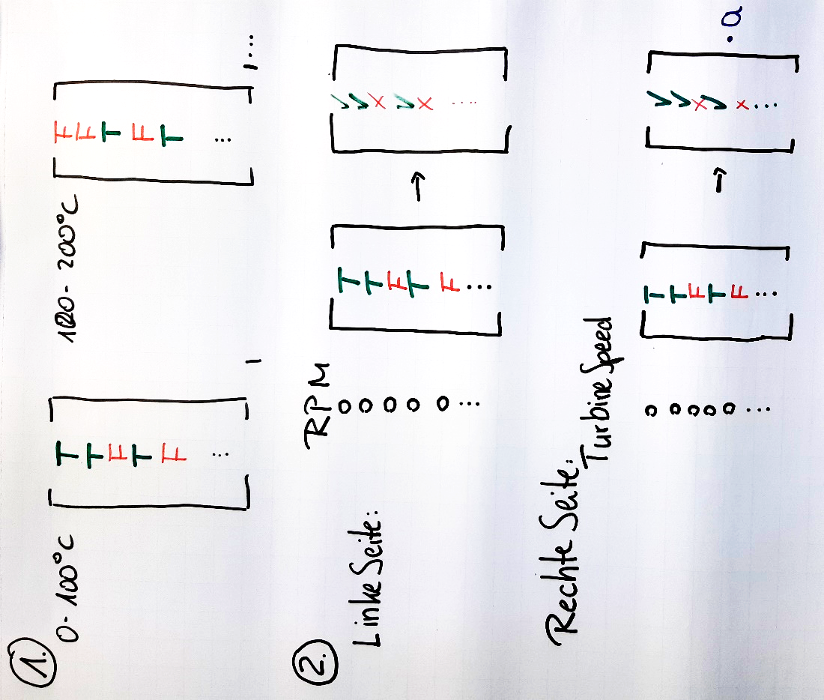
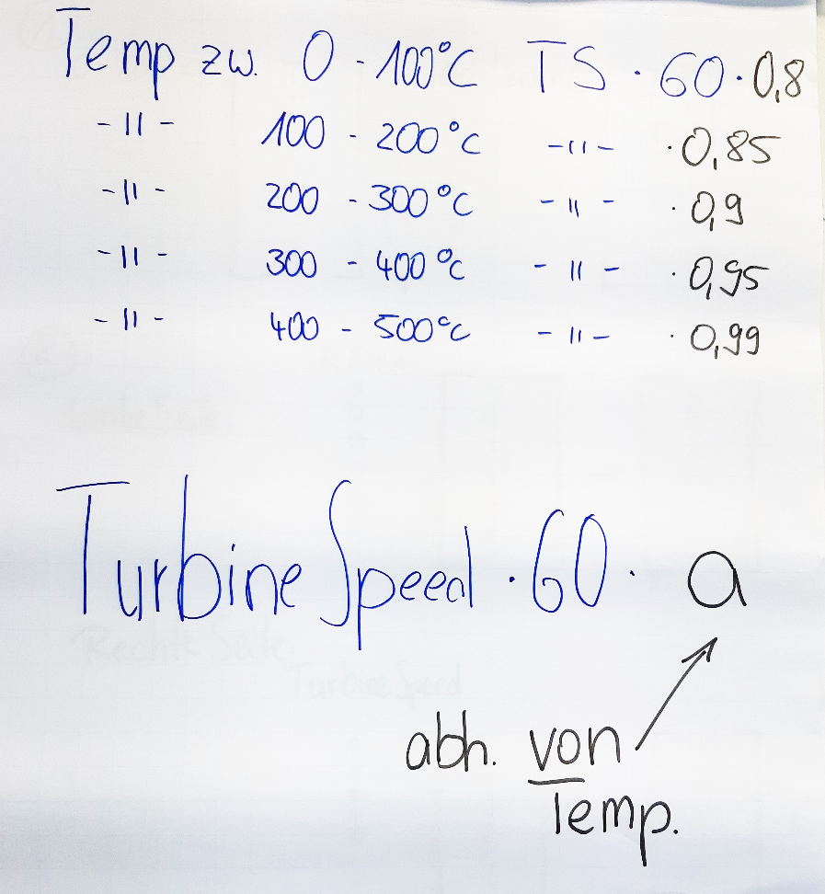
How to Calculate Efficiently in Pandas

Slide 42
Additional Slides for Data Science 3
Power and Gas – Large Gas Turbines, Generators

Slide 43
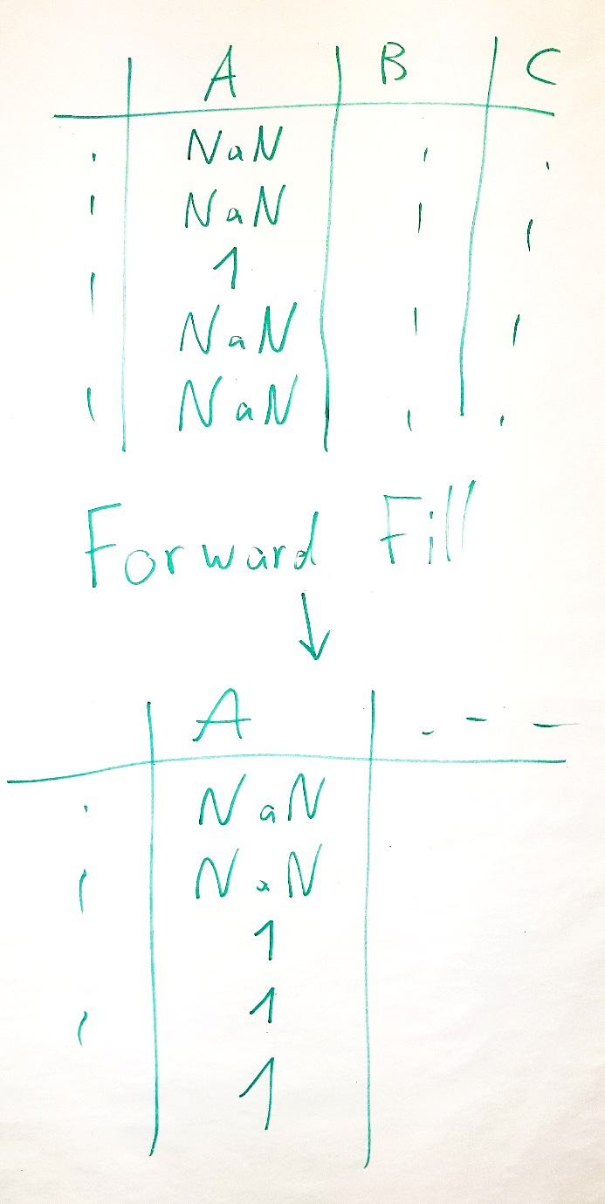
Fill

Slide 44
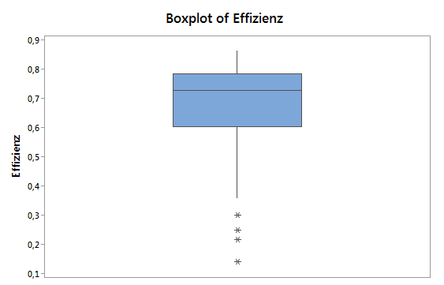
Box-Plot is a plot to show most things a Histogram shows by using much less space and therefore easy allows to compare many distributions. However, it is a bit harder to read than other graphs.
Boxplot of Efficiency
highest value above Q3+1.5 (Q3-Q1)
3. quartile (Q3): = 75% percentile
median
Efficiency
1. quartile (Q1): = 25% percentile
lowest value in Q1-1.5(Q3-Q1)
measured data outside of Q1-1.5(Q3-Q1) (so-called outliers)

